Slide 1
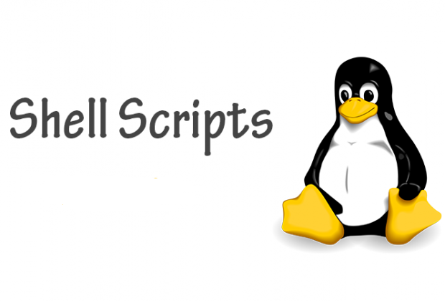

Slide 2
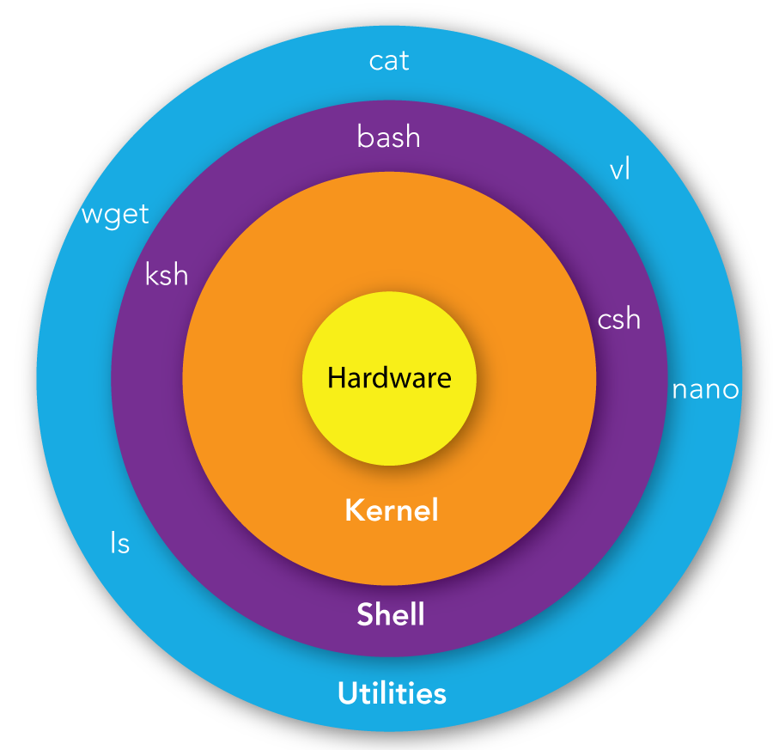
What is Shell
Shell is the environment in Unix/Linux in which we can run commands, programs, and shell scripts. The shell provides you with an interface in the Unix system. It takes commands from you, interprets them, sends them to the kernel, and can print the results to the screen

Slide 3
Shell categories:
Command Line Shell: Shell can be accessed by the user using a command line interface. A special program called Terminal in Linux/macOS or Command Prompt in Windows OS is provided to type in human-readable commands such as “cat”, “ls” etc
Graphical shell: Graphical shells provide means for manipulating programs based on the graphical user interface (GUI), by allowing for operations such as opening, closing, moving, and resizing windows, as well as switching focus between windows.

Slide 4
Types of Shells available in Linux System:
Bourne Again Shell (BASH): Developed at AT&T Bell Labs by Steve Bourne, the Bourne shell is regarded as the first UNIX shell ever.
The path name for the Bourne shell is /bin/sh. The Shell prompt is $ and execution on command sh.
C Shell (CSH): The C shell was created at the University of California by Bill Joy.
The path name for the C shell is /bin/csh. The Shell prompt is % and execution on command csh.
Korn Shell (KSH): The Korn shell was developed at AT&T Bell Labs by David Korn, to improve the Bourne shell. The path name for the Korn shell is /bin/ksh. The Shell prompt is $ and execution on command ksh.

Slide 5
What is Shell Scripting?
Shell scripts are a set of commands listed in the order of execution and it is a collection of Linux programs/commands
Advantages of Shell Scripting
The command and syntax are exactly the same as those directly entered in the command line, so programmers do not need to switch to entirely different syntax
Writing shell scripts are much quicker
Quick start
Interactive debugging

Slide 6


Basic Shell Script

Slide 7
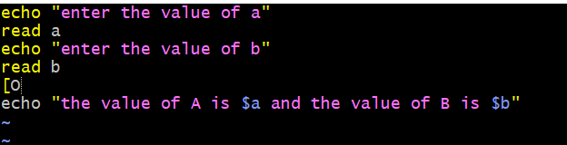
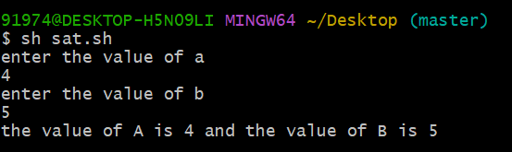
System Defined Variables

Slide 8
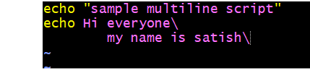

Multi-line Print Statement

Slide 9


Tab Print Statement

Slide 10

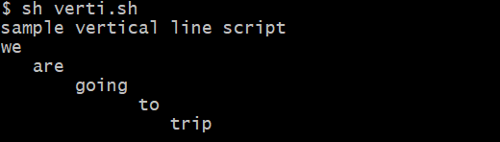
Vertical Line Print

Slide 11

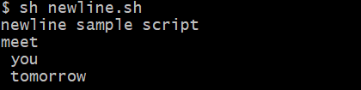
New Line Print

Slide 12
System Variables:
Echo ${Home} →
Echo ${OSTYPE} →
Echo ${Path} →
Echo ${$} →
Echo ${pwd} →
User Details
OS details
Display the path
Display the process ID
Present working directory

Slide 13


Read only

Slide 14


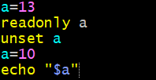

Unset
Readonly & unset

Slide 15
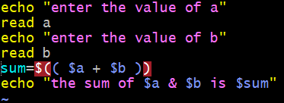
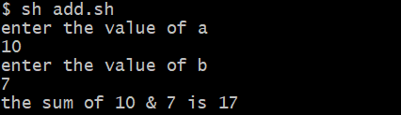
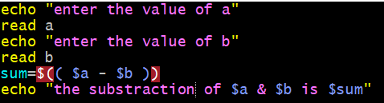
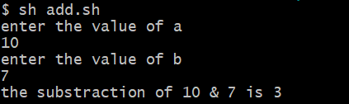
Expressions
Addition Expressions
Substraction Expressions

Slide 16
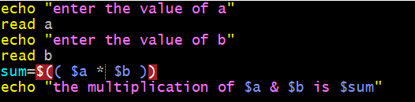
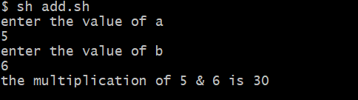
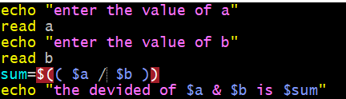
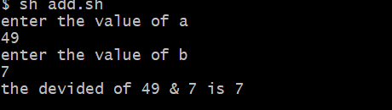
Multiplication Expressions
Devided Expressions

Slide 17
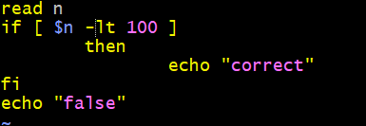
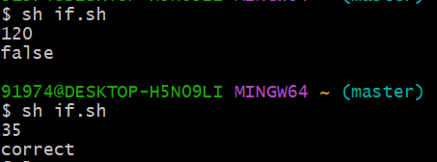
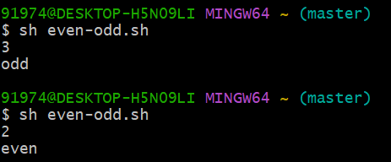
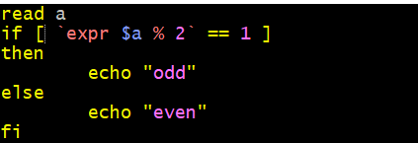
Conditional Statements
True - False
Even - Odd

Slide 18
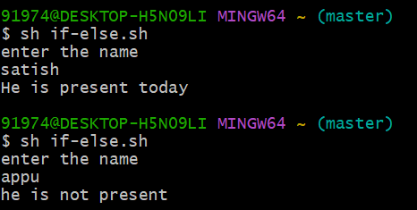
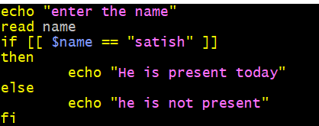
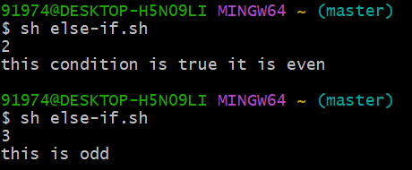
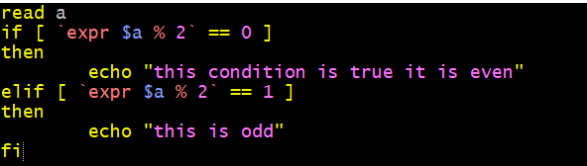
If - Else
Else - If

Slide 19
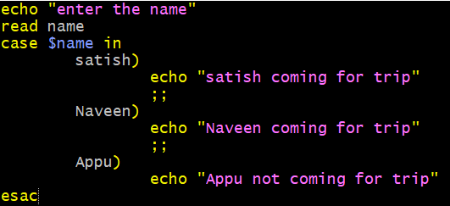
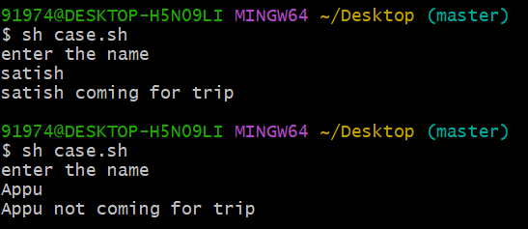
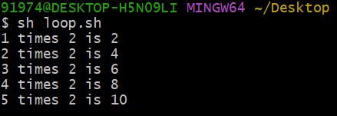
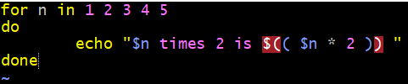
Case - esac
For Loops

Slide 20
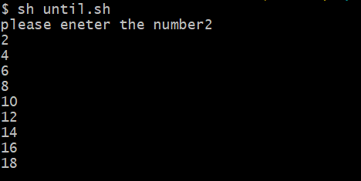
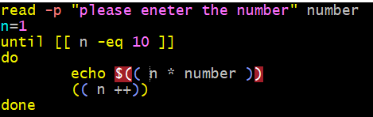
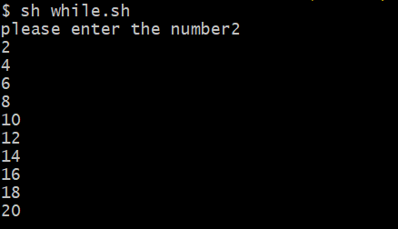
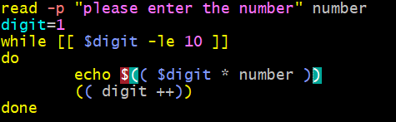
Until Loops
While Loops

Slide 21










Upper to Lower case / Lower to Upper case
String -

Slide 22
Disk Utilities: Disk Utilities make it easy for system administrators to easily monitor and manage disk partitions in Linux. In this article, we will look at the most popular disk utilities in Linux.
Fdisk (fixed disk): It is a popular disk utility to create and manage disk partitions in Linux. You can use it to create, resize, modify, delete and move disk partitions.
Command: fdisk -l
sfdisk : Scriptable fdisk is another disk utility that is similar to fdisk but offers more features.
Command: sfdisk -l

Slide 23
cfdisk (curses fdisk): cfdisk (curses fdisk) is a simple disk partitioning utility that allows you to manage disk partitions on your system.
Command: cfdisk
Parted: parted is another popular command for managing disk partitions. It is used to create new partitions and re-organize existing partitions
Command: parted -l
Lsblk (list block): lsblk command displays all available information about available and mounted block devices, such as name, type and mount point.
Command: lsblk

Slide 24
blkid (block id): is a utility that displays block device attributes such as deice or partition name, label, and filesystem.
Command: blkid
df: If you want to monitor disk usage, then df is the most popular command for this purpose. Here is a command to display total disk size, used space, available space and usage percent in human-readable formats
Command: df
→ Disk space
Command: df -hT
→ It will display content in human-readable format

Slide 25
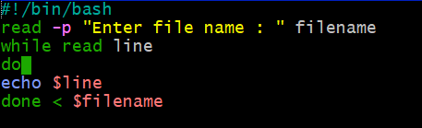
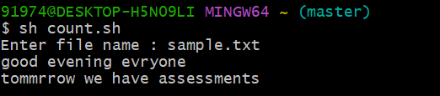
File Handling
Reading line by Line:

Slide 26
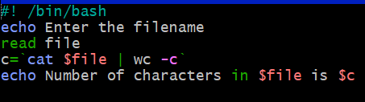


Counting Characters:

Slide 27
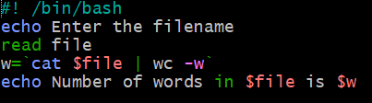

Counting Words:

Slide 28
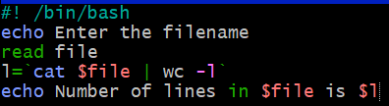


Counting Lines:

Slide 29
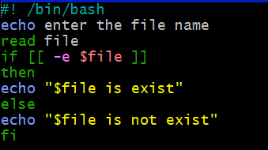
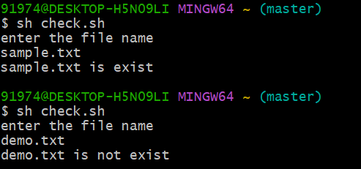
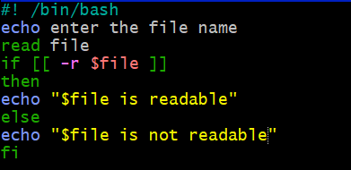
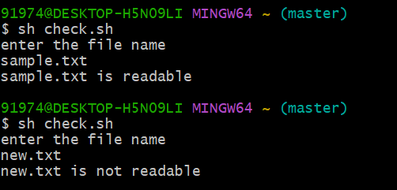
File Exists or Not:
File Readable or Not:

Slide 30
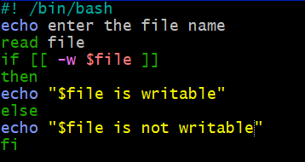
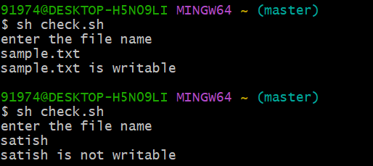
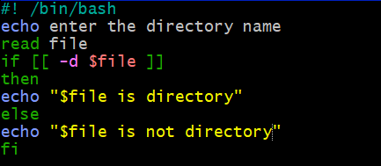
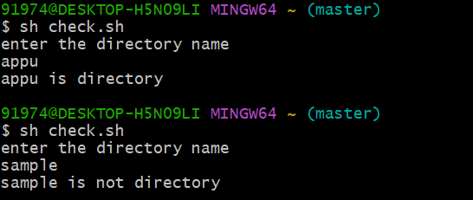
File Writable or Not:
File Directory or Not:

Slide 31
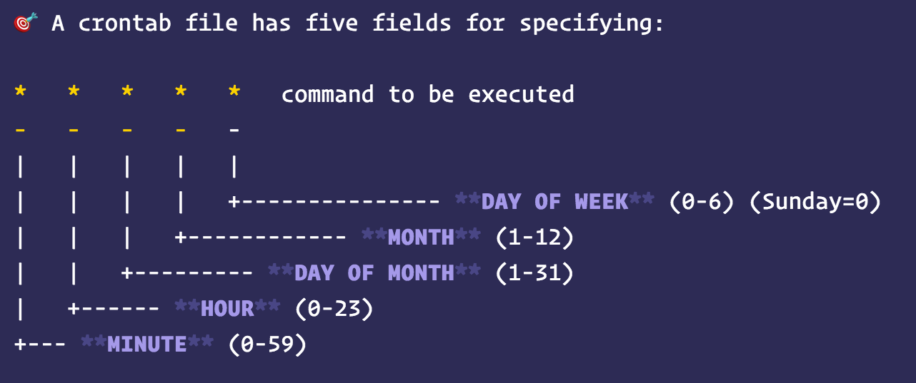
Crontab: Crontab stands for “cron table, ” because it uses the job scheduler cron to execute tasks; cron is named after “Chronos, ” the Greek word for time. cron is the system process that will automatically perform tasks for you according to a set schedule.

Slide 32
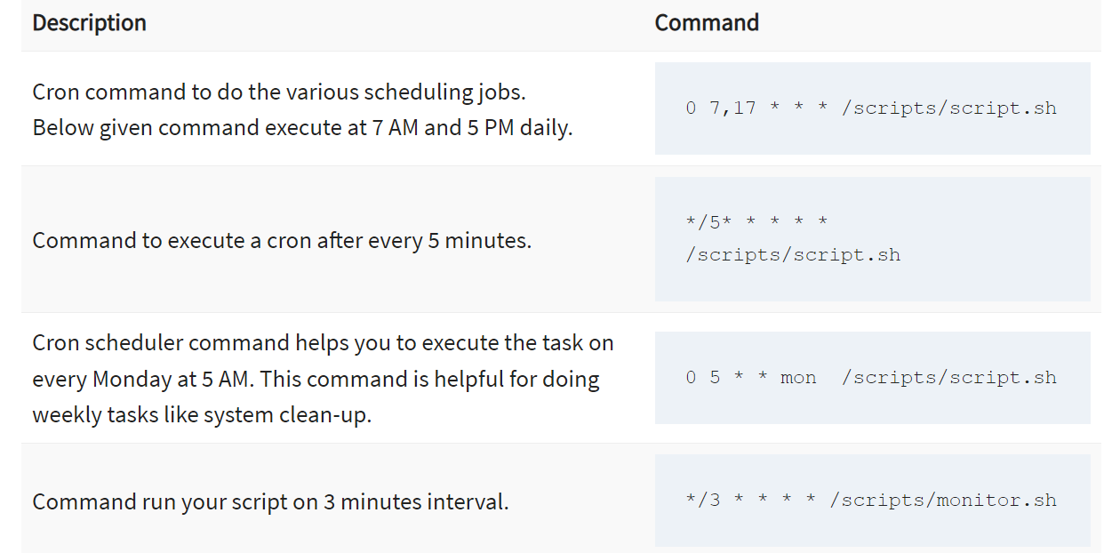
Crontab Examples:

Slide 33
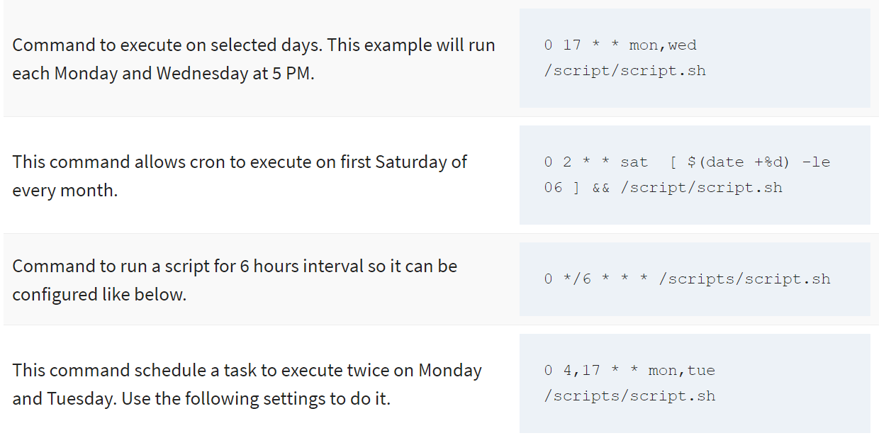
Crontab Examples:

Slide 34
Thank You

